Slide 1





Team: Nikitha Thangellapally -2844791 Manasa Moduga-2845854 Seshasai Vamsi Krishna Murthy-2845851 Neha Reddy-2828070
Food Wastage Management System

Slide 2
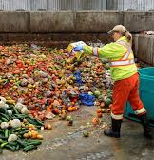
Problem Statement:
Casual parties and big gatherings involves excessive food and most of the food ends up in trash, getting wasted.
Food wastage also means wasting all the energy and water it takes to grow, harvest, transport, and package it.

Slide 3
Solution – Food Wastage Management System
Food wastage management system is a mobile application which allows users to raise a request to donate food to the needy.
This application particularly focuses on reducing food wastage and building a sustainable environment.

Slide 4
Getting into the Requirements:
The most important requirement of this project is to build a user-friendly application with vivid connecting screens which can direct user from signing in to placing a request

Slide 5
Design
Screens included for a user app
Main page
Registration page
Login page
Food wastage report page
Requests page
Screens included for admin
Login page
Request page

Slide 6
Architecture
.
User reports potential food wastage
User login
Client Authentication
Administratior authentication
Accept/reject requests

Slide 7
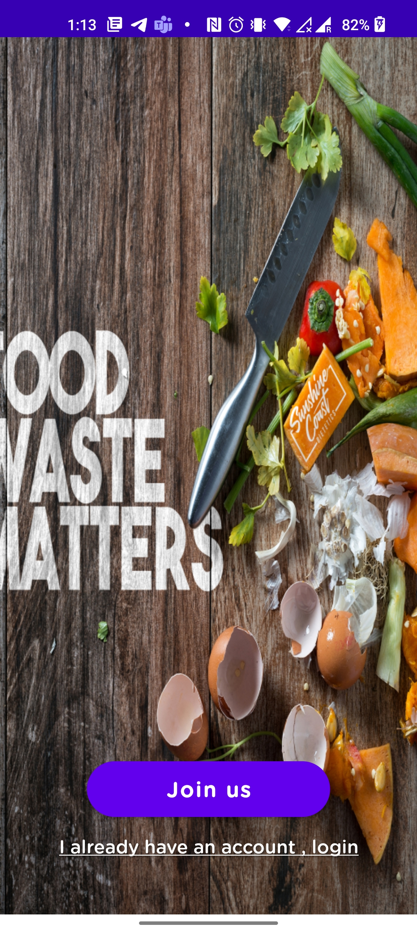
Main page:
This is the beginning page where the logo of the application is present
We also have link at the bottom to login/ sign up

Slide 8
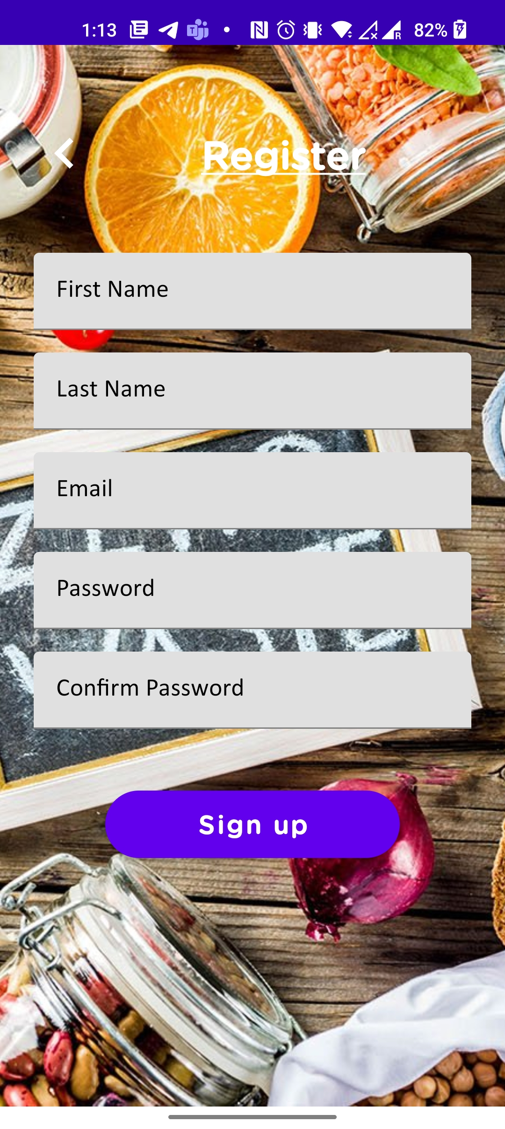
Registration page
New users can create an account here

Slide 9
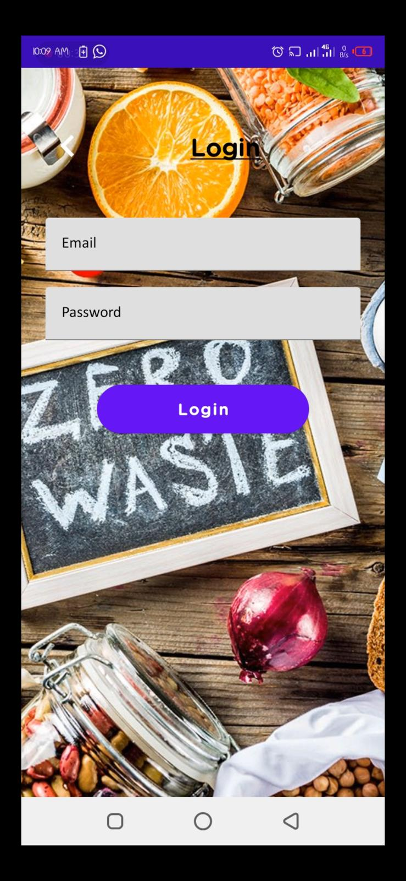
Login page
Users who are already registered with the application can directly login using their credentials

Slide 10
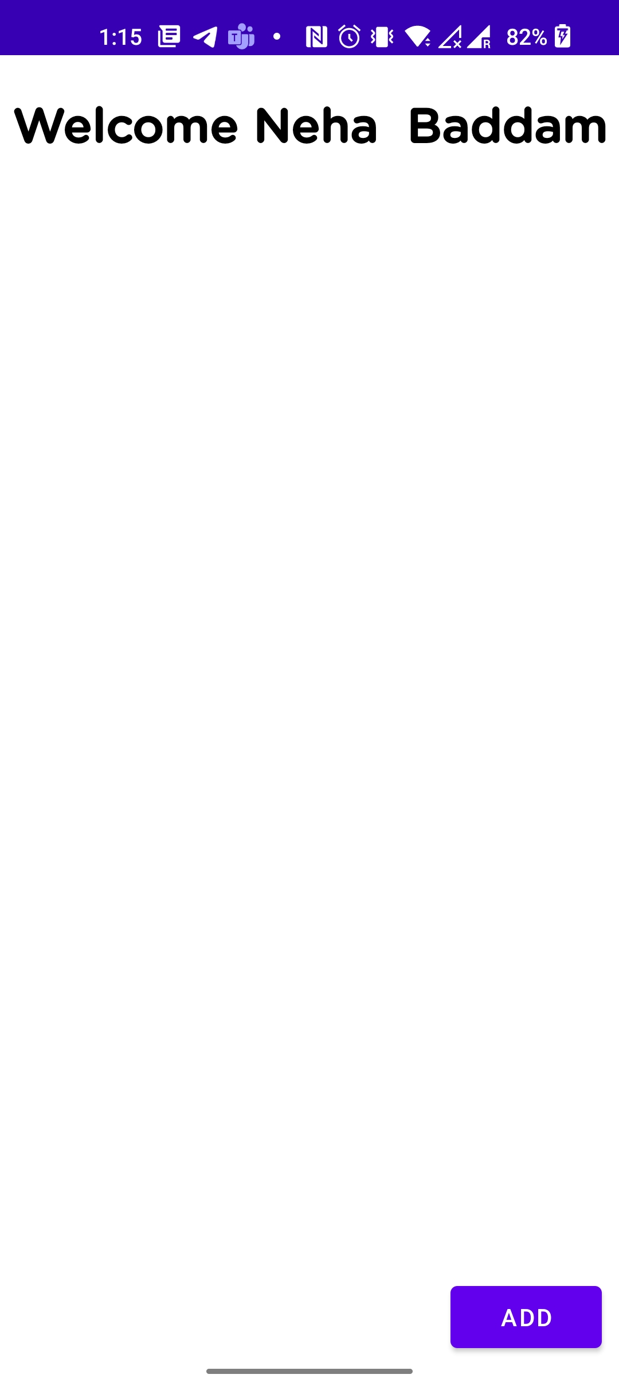
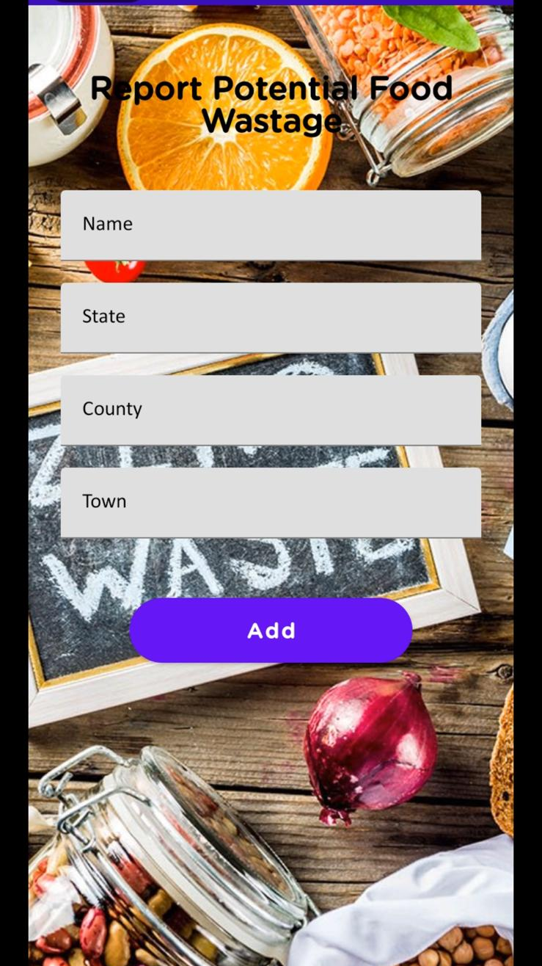
Food Wastage Report page
A user can add the details like (Name of the pace, state , country , town) of the location where there is extra food
This request sent to admin and admin can decide whether to accept or reject the request

Slide 11
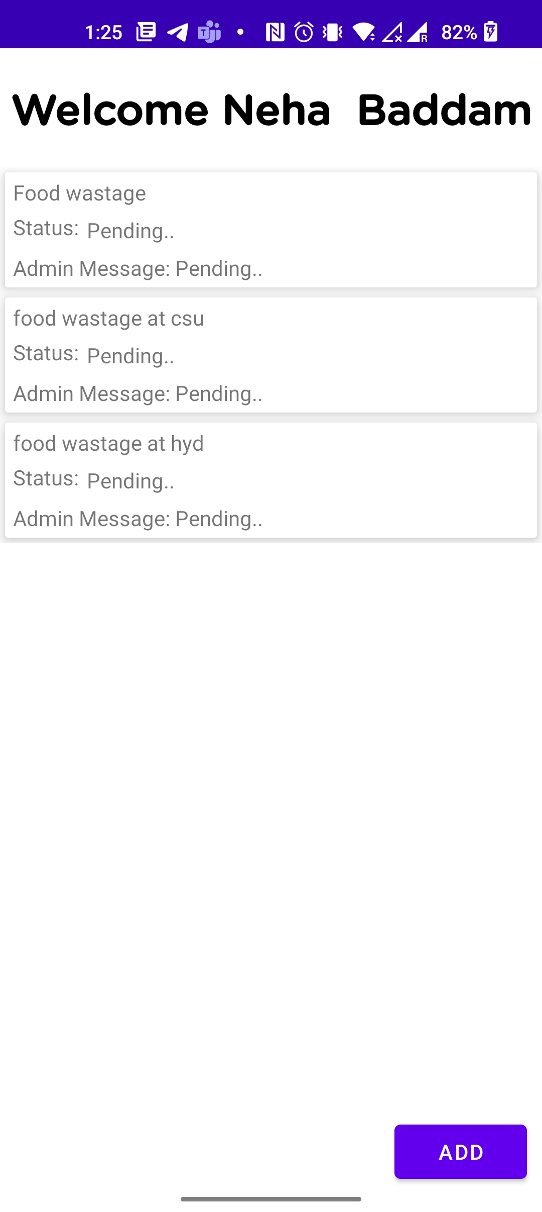
Requests page
A user can see the list of pending , accepted requests here

Slide 12
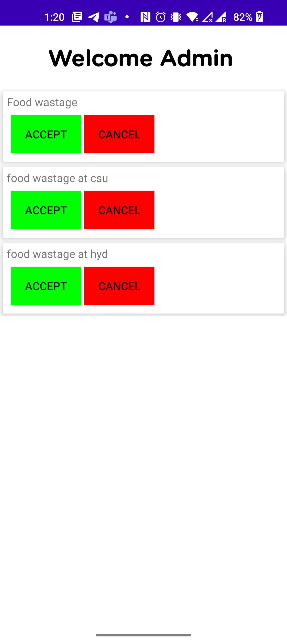
Admin side
The first page here is login page
The next page is requests page where admin can see the submitted requests and decide whether to accept or reject
Accepted requests are visible in the application

Slide 13
Technology used:
This project uses android studio application for development.
We used object box software and programmed in java db for database.
For testing, we plan to use MSSQL, and android studio installed.
The background coding is done using Java and JavaScript.

Slide 14
Limitations
Food wastage management application only runs on android and not on ios.

Slide 15
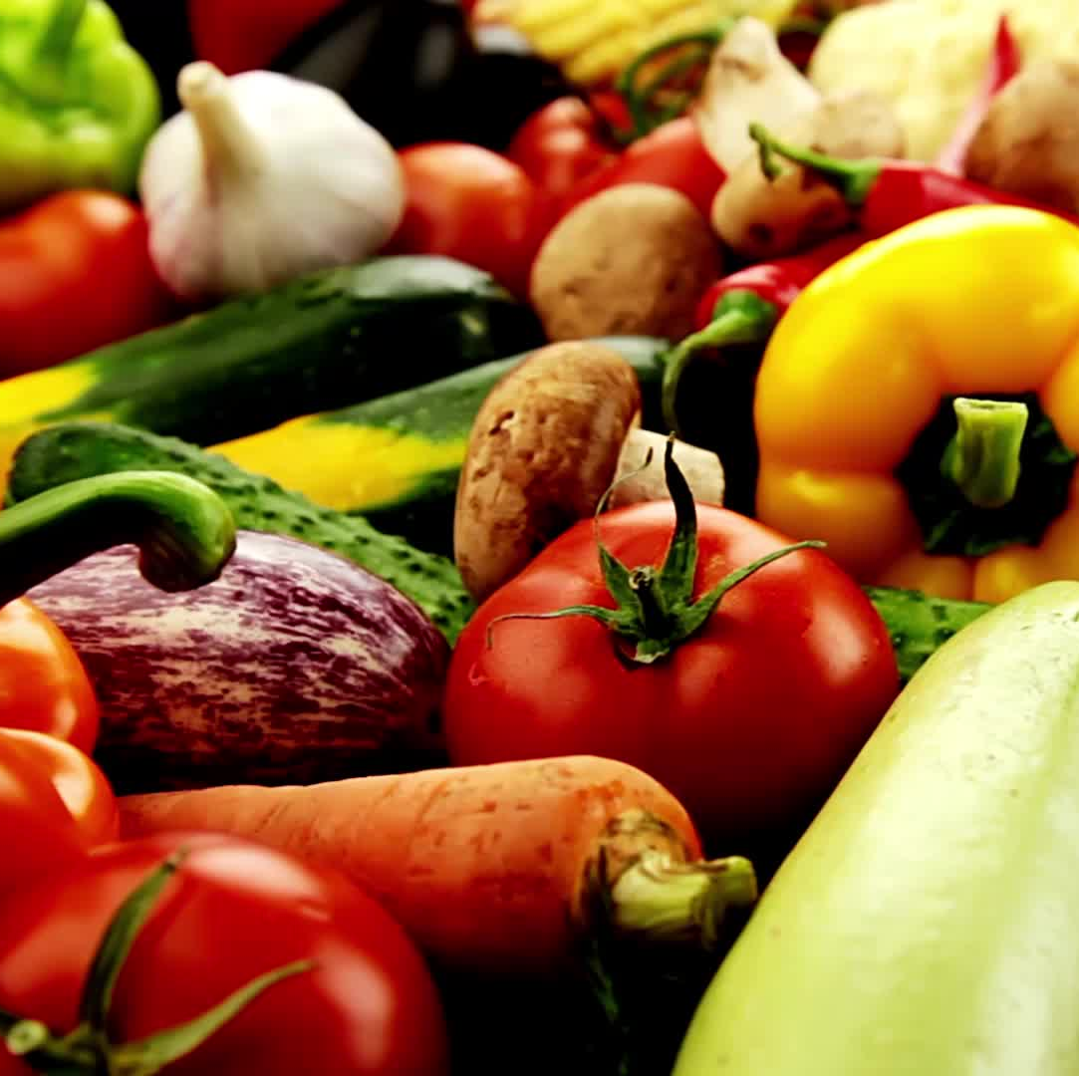
Conclusion
Food Wastage Management system focuses on providing users a friendly interface and allowing users to raise food wastage management requests helping the needy.

Slide 16
Thankyou

